Slide 1
SQL Fundamentals

Slide 2
Relational Databases
A relational database is one that stores data in tables.
The relationship between each data point is clear and searching through those relationships is relatively easy.
The relationship between tables and field types is called a schema.
For relational databases, the schema must be clearly defined.

Slide 3
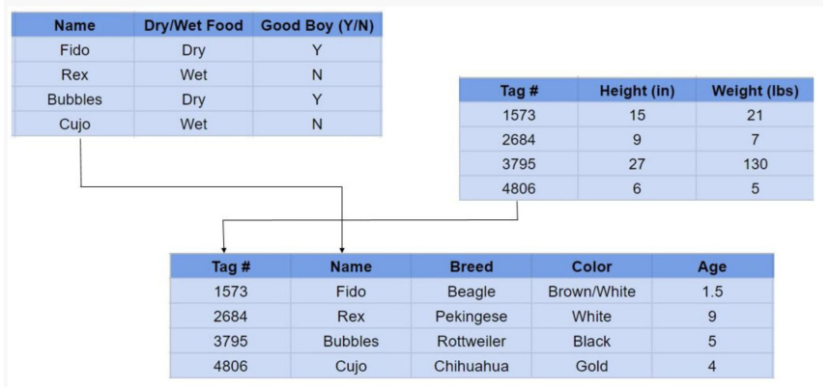
Relational Databases

Slide 4
Non-Relational Databases
A non-relational database is any database that does not use the tabular schema of rows and columns like in relational databases. Rather, its storage model is optimized for the type of data it’s storing
There are four different types of NoSQL databases.
Document-oriented databases – Also known as a document store, this database is designed for storing, retrieving and managing document-oriented information.
Key-Value Stores– This is a database that uses different keys where each key is associated with only one value in a collection. Think of it as a dictionary. This is one of the simplest database types among NoSQL databases.
Wide-Column Stores – This database uses tables, rows, and columns, but unlike a relational database, the names and format of the columns can vary from row to row in the same table.
Graph Stores – A graph database uses graph structures for semantic queries with nodes, edges, and properties to represent and store data.

Slide 5
Introduction to SQL
SQL (Structured Query Language) is a computer language aimed to store, manipulate and retrieve data stored in relational databases.
SQL language has several parts:
1) DDL - Data Definition Language
2) DML - Data Manipulation Language
3) View Definition
4) Transaction Control

Slide 6
Data Definition Language
DDL statements are used to define the database structure or schema. Examples :
CREATE
2) ALTER
3) DROP
4) RENAME

Slide 7
Data Manipulation Language
DML statements are used for managing data within schema objects. Examples :
SELECT
2) INSERT
3) UPDATE
4) DELETE

Slide 8
Basic Structure of SQL Query
General Structure - SELECT, ALL/ DISTINCT, *, AS, FROM, WHERE
Comparison - IN, BETWEEN, LIKE, ILIKE
Grouping - GROUP BY, HAVING, COUNT(), SUM(), AVG(), MAX(), MIN()
Display Order - ORDER BY, ASC/ DESC
Logical Operators - AND, OR, NOT
Output - INTO TABLE/ CURSOR, TO SCREEN
Union - UNION

Slide 9
SELECT & DISTINCT Statement
SELECT is the most common statement used, and it allows us to retrieve information from a table.
In order to select the entire table SELECT * is used.
Sometimes a table contains a column that has duplicate values and in order to return only the unique values, DISTINCT statement is used in combination with SELECT

Slide 10
COUNT Statement
COUNT returns the number of input rows that match a specific condition of a query
COUNT can be applied on a specific column or just passed as COUNT(*), both giving same results

Slide 11
WHERE Statement
WHERE statement allows us to specify the conditions on columns for the rows to be returned
OPERATOR | DESCRIPTION
= | EQUAL
> | GREATER THAN
< | LESS THAN
>= | GREATER THAN OR EQUAL TO
<= | LESS THAN OR EQUAL TO
<> OR != | NOT EQUAL TO
AND | BOTH CONDITIONS TRUE
OR | EITHER OF THE CONDITIONS TRUE
NOT | OFFSET OF SPECIFIED CONDITION

Slide 12
ORDER BY Statement
SELECT company, name, sales FROM table
ORDER BY company, sales
COMPANY | NAME | SALES
Apple | Andrew | 100
Apple | Zach | 300
Google | Claire | 200
Google | David | 500
Xerox | Steven | 100

Slide 13
LIMIT Statement
The LIMIT command allows us to limit the number of rows returned for a query.
Useful for not wanting to return every single row in a table, but only view the top few rows to get an idea of the table layout
LIMIT also becomes useful in combination with ORDER BY
LIMIT goes at the very end of a query request and is the last command to be executed

Slide 14
BETWEEN Statement
The BETWEEN operator can be used to match a value against a range of values
value BETWEEN low AND high
Can be combined with NOT operator
Can be also used with dates in the format : YYYY-MM-DD

Slide 15
IN Statement
The IN operator can be used to create a condition that checks to see if a value is included in a list of multiple options for example if a user’s name shows up in a list of know names
value IN ( option 1, option 2, option 3,........., option N

Slide 16
LIKE & ILIKE Statement
In order to match a string against a general pattern we use LIKE and ILIKE for example:
All emails ending with ‘@gmail.com’
LIKE & ILIKE allows us to perform pattern matching against string data with the use of wildcard characters
● Percent % - Matches any sequence of characters
● Underscore _ - Matches any single character
LIKE is case-sensitive whereas ILIKE is case-insensitive

Slide 17
Contd…
All names that begin with ‘A’
WHERE name LIKE ‘A%’
All names that end with ‘a’
WHERE name LIKE ‘%a’
Get all Mission Impossible Films
WHERE name LIKE ‘Mission Impossible _ _’
Combination of Wildcards
WHERE name LIKE ‘_ her%’
● Cheryl
● Theresa
● Sherri

Slide 18
Aggregate Functions
The main idea behind aggregate function is to take multiple inputs and return a single output
● AVG() - Returns floating point values.
ROUND() can be used to specify precision after the decimal
● COUNT()
● MAX()
● MIN()
● SUM()

Slide 19
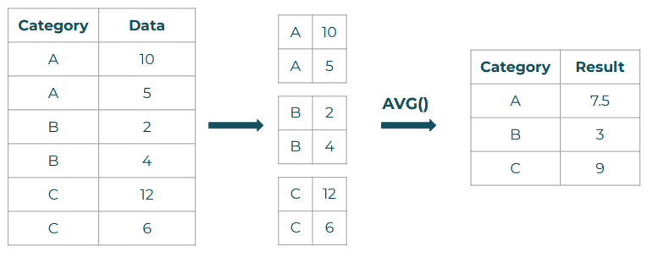
GROUP BY Statement
GROUP BY allows us to aggregate data and apply functions to better understand how data is distributed per category

Slide 20
HAVING BY Statement
HAVING allows us to filter after an aggregation has already taken place.
We can use it along with a GROUP BY
Syntax:
SELECT column_name(s) FROM table_name WHERE condition GROUP BY column_name(s) HAVING condition ORDER BY column_name(s);

Slide 21
AS Statement
AS allows us to create an Alias for a column or a result
SQL aliases are used to give a table, or a column in a table, a temporary name.
AS operator gets executed at the very end of the query meaning we can not use the Alias inside a WHERE or HAVING operator

Slide 22
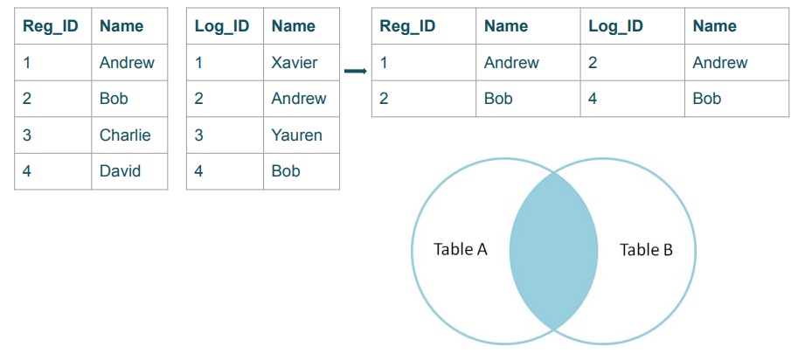
INNER JOIN Statement

Slide 23
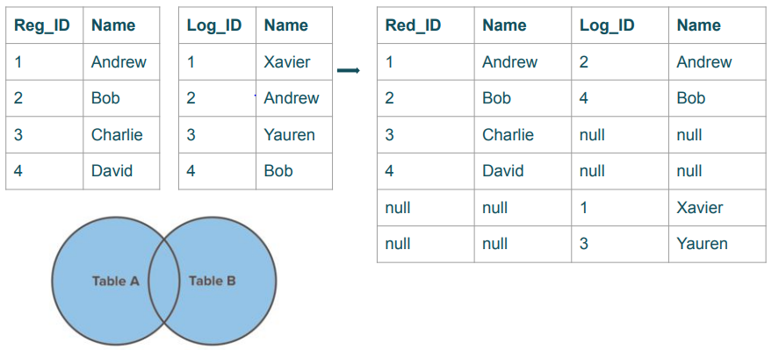
FULL OUTER JOIN Statement

Slide 24
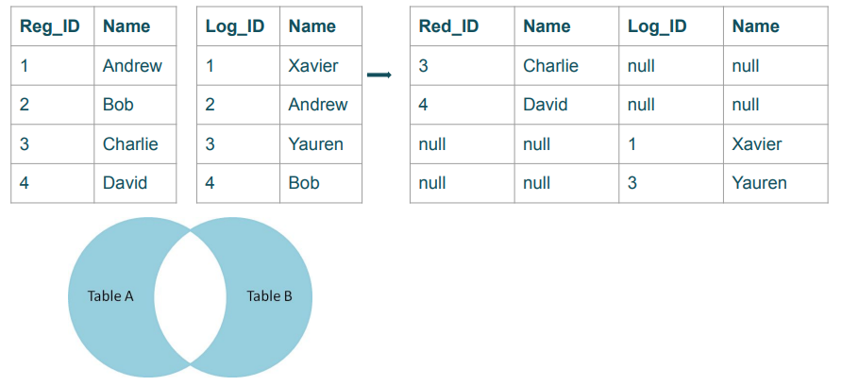
FULL OUTER JOIN with WHERE

Slide 25
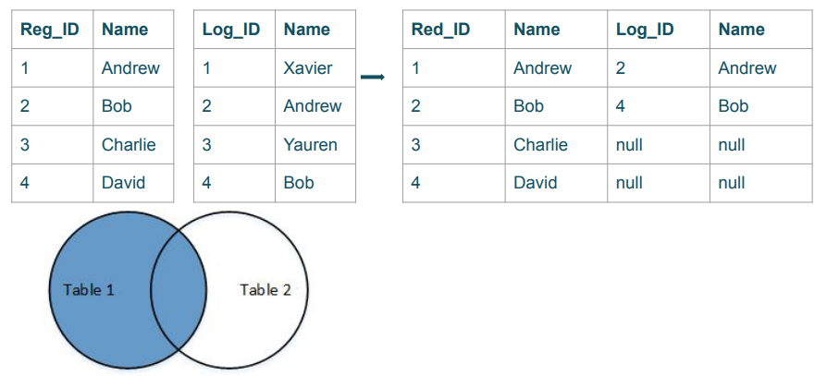
LEFT OUTER JOIN Statement

Slide 26
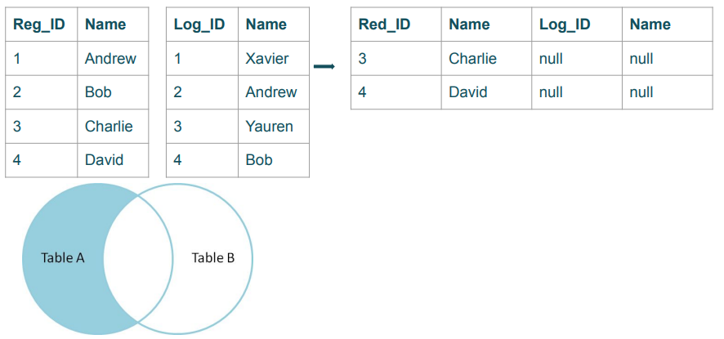
LEFT OUTER JOIN with WHERE

